Slide 1
Determination of Top Five Countries which are in the needs of the aid

Slide 2
Problem Statement:-
HELP International is an international humanitarian NGO that is committed to fighting poverty and providing the people of backward countries with basic amenities and relief during the time of disasters and natural calamities.
NGO have been able to raise around $ 10 million. Now the CEO of the NGO needs to decide how to use this money strategically and effectively.
NGO wants to split into clusters and find out the needs based on the variables [gdpp, child_mort and income].
Report back at least 5 countries which are in direst need of aid

Slide 3
Steps involved in the Analysis
1)Reading and Understanding the dataset.
2)EDA for Clustering
Removing Missing/Null values
Outlier Treatment
Hopkins Test
Rescaling
K- Means Method
1) Using both Elbow Curve & Silhouette Score finding the K value
2)Visualize the clusters.
3)Cluster Profiling
Hierarchical Clustering
1) Creating Dendrogram using both Single and Complete linkage
2) Cut the Dendrogram to determine the cluster size.
3)Visualize the clusters.
4)Cluster Profiling
Conclusion
Country identification

Slide 4
Reading and Understanding the dataset
Step 1:-
Importing the data into pandas data frame.
Inspecting the data frame using inspections methods like Info, shape, describe etc.
Few variables present in the data set for which the values are calculated based on the total population of the country, which will give us issue while building the model. So the variable results have been recalculated.

Slide 5
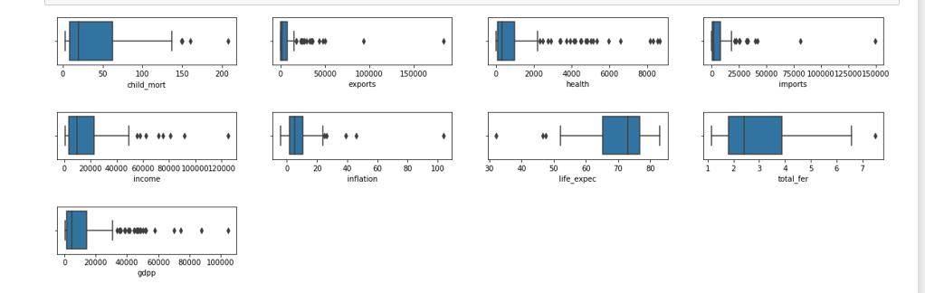
Data Preparation (EDA)
Removing Missing/Null values from the dataset- But there is no Missing/Null values in our dataset.
Outlier Treatment:-
Box plot to find out the outliers.
Using the capping treatment the values are recalculated.

Slide 6
Data Preparation (EDA)
Rescaling – to have the comparable scale using SK-learn.
Hopkins Statistics Testing:-
The Hopkins statistic is a way of measuring the cluster tendency of a data set. It belongs to the family of sparse sampling tests. It acts as a statistical hypothesis test where the null hypothesis is that the data is generated by a Poisson point process and are thus uniformly randomly distributed.
For the given data set the hopkins score is 0.87 tendency is high for the given data set .

Slide 7
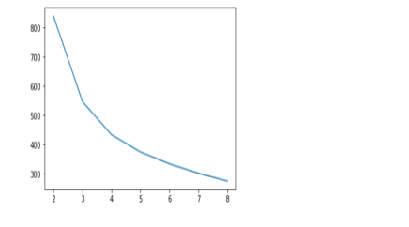
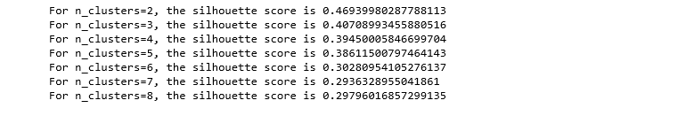
K-Means
Finding Number of cluster
Using Elbow Curve –finding the K value.
Using Silhouette Score – finding the K value.
1)From the elbow curve we could find cluster=3 has significant curve.
2)The silhouette score is high for the cluster k=2 but splitting the data into two groups will not give much details to business. So the k values is considered as 3

Slide 8
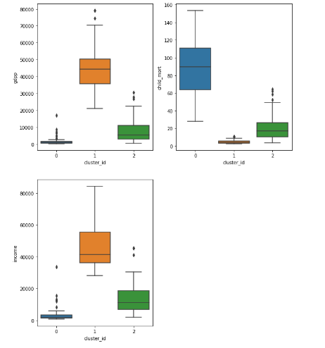
K-Means Clustering Continues
Cluster Profiling:-
By using box plot we can able to determine the groping/clusters happed based on similarities of the datasets.
From the graph we can infer that Cluster=0 having high child_mort, low Gdpp & low-income countries are grouped/clustered together.

Slide 9
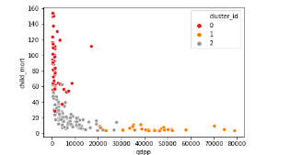
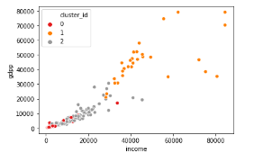
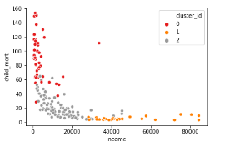
K-Means Clustering Continues
Creating Cluster profiling using Gdpp, Child_Mort & Income attributes.
Visualizing the Clusters:
Gdpp vs Child Mort:-
Low income and high Mortality
Gdpp vs Income:
Gdpp and income are directly
Proportional to each other
Income vs Child Mort:
Low income and high Mortality

Slide 10
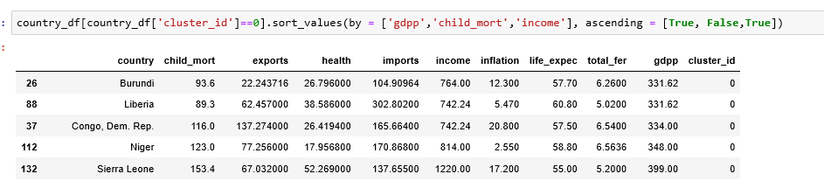
K-Means Clustering Continues
Country Identification:
From Kmeans ,Below listed top 5 countries are in need for the aid. Listed countries are having less income, less Gdpp and high child mortality rate.
Burundi
Liberia
Congo,Dem,Rep
Niger
Sierra Leone

Slide 11
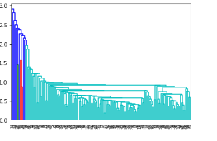
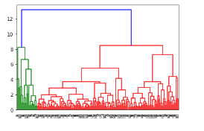
Clustering Using Hierarchical
Using Hierarchical Clustering:
- Create the Dendrogram using both Single
& Complete Linkage.
Determination of K values using Hierarchical Clustering:
By using Divisive Clustering we can set the threshold > 8
Cut the dendrogram to
determine the no of clustering
We got 3 Cluster as significant using Hierarchical Clustering

Slide 12
Hierarchical Clustering Continues
Creating Cluster profiling using Gdpp, Child_Mort & Income attributes.
Visualizing the Clusters:
Gdpp vs Child Mort:-
Low income and high Mortality
Gdpp vs Income:
Gdpp and income are directly
Proportional to each other
Income vs Child Mort:
Low income and high Mortality

Slide 13
Hierarchical Clustering Continues
Cluster Profiling:-
By using box plot we can able to determine the groping/clusters happed based on similarities of the datasets.
From the graph we can infer that Cluster=0 having high child_mort, low Gdpp & low-income countries are grouped/clustered together.

Slide 14
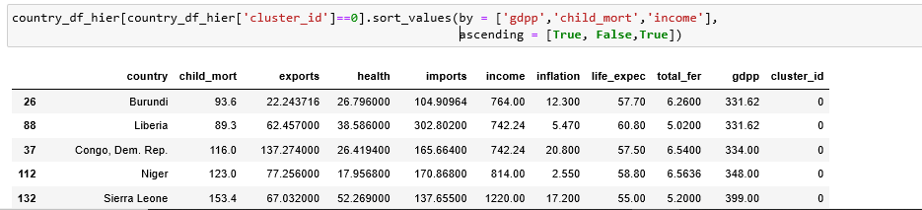
Hierarchical Clustering Continues
Country Identification:
From Hierarchical ,Below listed top 5 countries are in need for the aid. Listed countries are having less income, less Gdpp and high child mortality rate.
Burundi
Liberia
Congo,Dem,Rep
Niger
Sierra Leone

Slide 15
Conclusion for both Hierarchical and K- Means
Conclusion:-
Based on the both Hierarchical & K- Means clustering.Below listed top 5 countries are in need for the aid. Listed countries are having less income, less Gdpp and high child mortality rate.
Burundi
Liberia
Congo,Dem,Rep
Niger
Sierra Leone
CEO needs to focus on the above countries.

